Slide 1
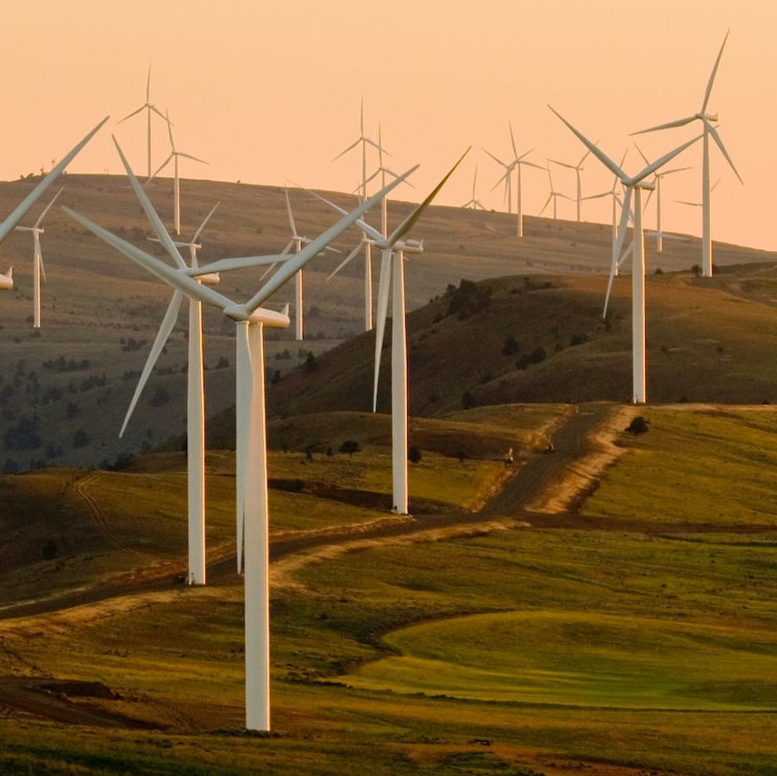
WIND FARM
Characteristics for a wind farm of 50 WT
Power: 4.2 MW
Lifetime: 25 yrs
Efficiency loss: 0.4% per year

Slide 2
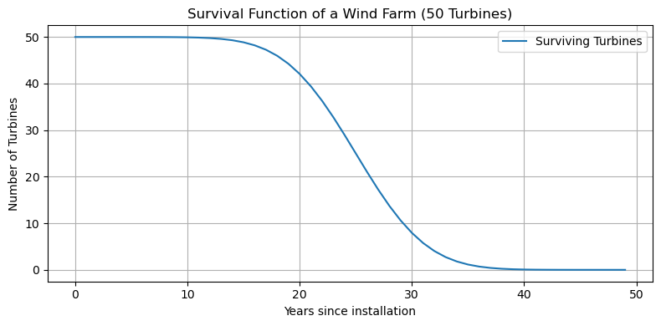

Slide 6
Efficiency loss of 0.4%/yr

